Slide 1
STT 465 (Fall, 2016): Bayesian Statistical Methods
Instructor: Gustavo de los Campos (Asoc. Prof., EPI-Biostat & Statistics)
Contact: gustavoc@msu.edu
Primary office: 909 Fee Rd. Room B637
Websites: http://quantgen.github.io
Office Hours: MW 9:00-10:00 AM (Wells, office TBA)
Course website: https://github.com/gdlc/stt465
Syllabus: see course website for info about the course, pre-requisites,
grading, etc.
Pre-requisites, rules, exams & grading policy (see syllabus)

Slide 2
Tentative Schedule

Slide 3
Introduction
Statistical learning: we use data collected on finite number of subjects (sample) to learn about features of the entire population.
Example: Survey N individuals about likely vote in the coming presidential election and make inferences about preferences about the entire population of likely voters.
The process of statistical learning
Data => Estimates and Measures of Uncertainty

Slide 4
Statistical Inference
Review of basic concepts:
- Population Y={y₁,…} (may be finite or infinitely large).
- Sample We collect a sample of size n from the population Y_{s}={y_{1,…,}y_{n})
- Estimator:
Inference: we make statements about population parameters based on the sampled data.
Two approaches:
- Classical (frequentist) inference: statements are based on the sampling distribution of the estimator over conceptual repeated sampling
- Bayesian: statements are conditional on the observed data (the only sample we have drawn from the population).

Slide 5
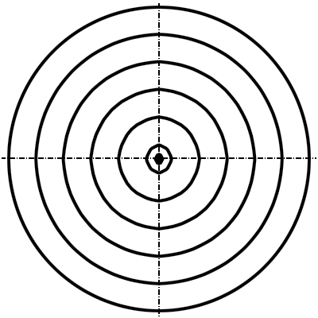
Frequentist approach
Sampling Distribution of Estimates
Squared-Bias
Variance

Slide 6
Bayesian approach
Elements of a Bayesian Model
(1) Sampling model:
- Describes the probability of the data given a set of parameters
(2) Prior distribution: describe our beliefs about possible values of the parameters before we observe data.
(3) Posterior distribution: the probability of the parameters given the sample
Describe our beliefs after we observe data.
(4) We arrive at the posterior distribution using Bayes’ Theorem
=
p(Y)

